Slide 1

AI – Driven Guest Experience Personalization System for Hospitality
Vikash Kushwaha
Mentored By :-
Arkajit Dutta

Slide 2
Introduction
This project focuses on building an advanced LLM-based chatbot leveraging Groq LLM for efficient and high-speed natural language processing. Jina AI is integrated for intelligent search and retrieval-based augmentation, while Mem0 optimizes memory and context handling for better conversational continuity. ChromaDB is used to store the dataset in the form of chunks and CrewAI acts as the orchestration layer, managing multiple AI agents for task-specific roles, enhancing automation, and improving multi-agent collaboration. This architecture enables a highly efficient, context-aware, and scalable chatbot solution. The application is built using Streamlit for an interactive UI and FastAPI to manage backend processing and API endpoints.

Slide 3
Problem Statement

Slide 4
Lack of Fast and Efficient AI Chatbots:
Traditional chatbots struggle with response speed and efficiency, leading to delays in user interactions.
Need for a high-performance model like Groq LLM to enhance real-time conversation processing.
Context Retention Issues in Conversations:
Many AI chatbots fail to maintain long-term memory of conversations, causing repetitive or irrelevant responses.
Utilizing Mem0 can help preserve conversation history for improved contextual understanding.
Limited Knowledge Retrieval Capabilities:
Standard chatbots rely solely on predefined responses and fail to provide accurate real-time information.
Integrating Jina AI for intelligent search and retrieval-based augmentation enhances knowledge accessibility.

Slide 5
Inefficient Multi-Agent Collaboration in AI Systems:
Current AI solutions lack dynamic orchestration for task-specific operations, limiting scalability.
Implementing CrewAI enables better task delegation and multi-agent collaboration.
Complex Backend Management for Scalable AI Systems:
Traditional chatbot architectures face performance bottlenecks due to inefficient API handling.
FastAPI ensures lightweight, scalable, and efficient backend service management.
User Experience and Interface Limitations:
Many AI chatbots have non-intuitive interfaces, making them less user-friendly.
Leveraging Streamlit provides an interactive, visually appealing, and easy-to-use UI for seamless engagement.

Slide 6

Objectives

Slide 7
Enhance Response Speed and Efficiency
Utilize Groq LLM to generate fast and accurate responses for real-time user interactions.
Improve Context Retention in Conversations
Integrate Mem0 to maintain memory and ensure continuity in long conversations.
Enable Intelligent Knowledge Retrieval
Leverage Jina AI to fetch relevant information dynamically for better and more precise responses.
Implement Multi-Agent Collaboration
Use CrewAI to coordinate AI agents, automating complex tasks efficiently.
Ensure Scalable and Robust Backend Architecture
Develop the backend using FastAPI to handle high-concurrency requests with minimal latency.
Provide an Intuitive and Interactive User Interface
Utilize Streamlit to design a visually appealing, user-friendly chatbot interface.
Optimize System Performance and Scalability
Implement best practices for AI model optimization, API handling, and distributed processing.
Enhance Real-World Applications and Use Cases
Develop a chatbot adaptable to various domains like customer support, healthcare, and enterprise automation.
7

Slide 8

Architecture Diagrams
8

Slide 9
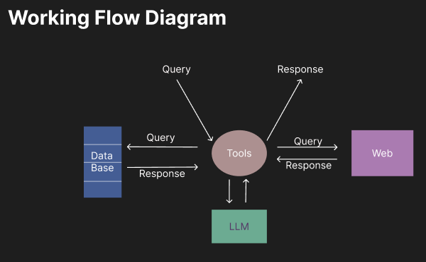
9

Slide 10
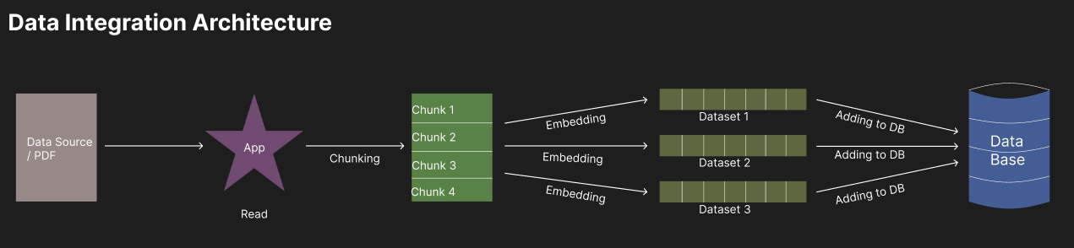
10

Slide 11
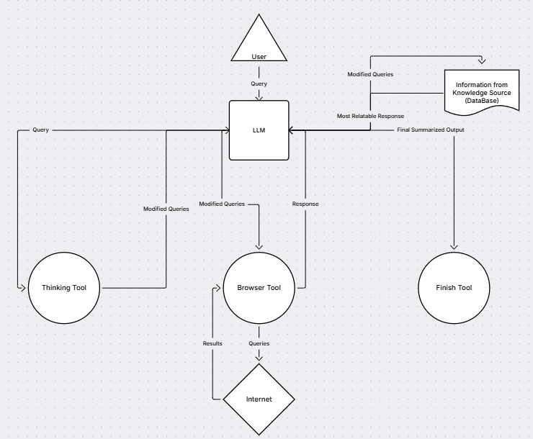
Agent / Tools Architecture Diagram
11

Slide 12
Technology Stack
1. Language & Frameworks
Python – Primary programming language for development.
Streamlit – Frontend framework for building an interactive UI.
FastAPI – Backend framework for managing API requests and responses.
2. Large Language Model (LLM)
Groq LLM – High-speed, efficient language model for text generation.
3. Search & Retrieval
Jina AI – Intelligent search and retrieval-based augmentation for relevant responses.
4. Memory & Context Management
Mem0 – Memory persistence for tracking conversation history and improving continuity.
5. Multi-Agent Orchestration
CrewAI – Manages multiple AI agents to execute complex tasks dynamically.

Slide 13
6. API & Backend Communication
FastAPI – Handles API interactions efficiently.
RESTful APIs – Enables integration with external services.
7. Data Storage & Processing
ChromaDB – Vector database for efficient retrieval-augmented generation (RAG) and knowledge storage.
Vector Databases (e.g., Weaviate, Pinecone, or FAISS) – Stores embeddings for retrieval-based responses.
PostgreSQL / MongoDB – Stores structured and unstructured data for chat history and analytics.
8. Deployment & Hosting
Docker – Containerization for scalable deployment.
Kubernetes – Orchestration for managing containers in production.
AWS / GCP / Azure – Cloud hosting for scalability and availability.
9. Security & Authentication
OAuth2 / JWT – Secures API endpoints.
SSL/TLS Encryption – Ensures secure data transmission.

Slide 14
Features
1. High-Speed & Efficient Response Generation
Powered by Groq LLM for ultra-fast, accurate text generation.
2. Context-Aware Conversations
Utilizes Mem0 to retain and recall conversation history for seamless user interactions.
3. Intelligent Knowledge Retrieval
Integrates Jina AI and ChromaDB for efficient search and retrieval-augmented generation (RAG).
4. Multi-Agent Collaboration
CrewAI manages multiple AI agents to handle different tasks dynamically.
5. Scalable & Robust Backend
FastAPI ensures efficient API handling and high-performance request processing.

Slide 15
6. Interactive & User-Friendly Interface
Built with Streamlit, providing an intuitive and responsive UI.
7. Advanced Memory & Personalization
Mem0 enables personalized responses based on previous interactions.
8. Task Automation & API Integrations
Supports third-party API calls via FastAPI for dynamic responses.
9. Secure & Reliable Architecture
Implements OAuth2 / JWT authentication and SSL/TLS encryption for security.
10. Cloud-Based & Scalable Deployment
Deployable on AWS, GCP, or Azure with Docker & Kubernetes for scalability.

Slide 16

Future Improvements

Slide 17
Enhanced Multimodal Capabilities
Integrate image, voice, and video processing for a richer user experience.
Support speech-to-text and text-to-speech interactions.
Advanced Personalization & Adaptive Learning
Implement user profiling for more context-aware and personalized responses.
Use reinforcement learning to improve chatbot adaptability over time.
Improved Memory & Long-Term Context Handling
Enhance Mem0 with hierarchical memory structures for better long-term recall.
Optimize ChromaDB for more efficient retrieval-based generation (RAG).
Better Multi-Agent Collaboration & Task Automation
Expand CrewAI to support more specialized agents for complex workflows.
Enable AI-driven task delegation for enterprise automation.
17

Slide 18
Integration with External Knowledge Bases & APIs
Connect with external databases, CRM systems, and enterprise tools for real-time data access.
Implement plugin-based architecture for easy third-party integrations.
Deployment & Performance Optimization
Use serverless computing (e.g., AWS Lambda) for cost-effective scaling.
Optimize Groq LLM inference for faster processing with lower resource consumption.
Security & Privacy Enhancements
Implement end-to-end encryption for user data protection.
Enable fine-grained access control and GDPR-compliant data handling.
Multi-Language Support
Expand to multiple languages and dialects for a global user base.
Implement real-time translation capabilities for cross-language communication.
18

Slide 19
Screenshots

Slide 20
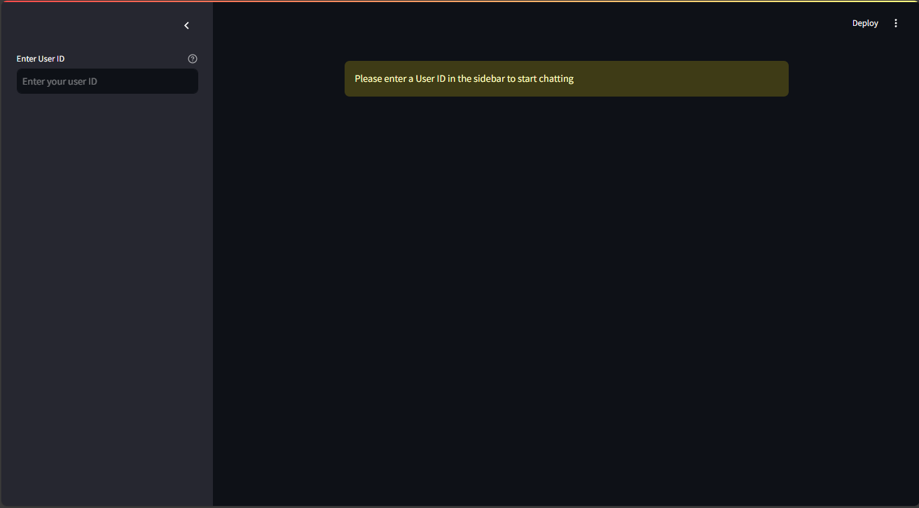
20

Slide 21
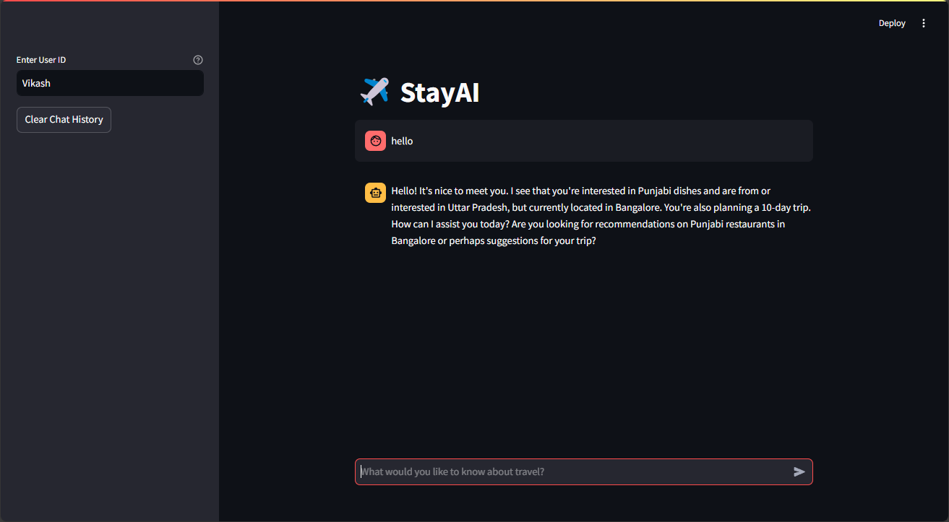
21

Slide 22
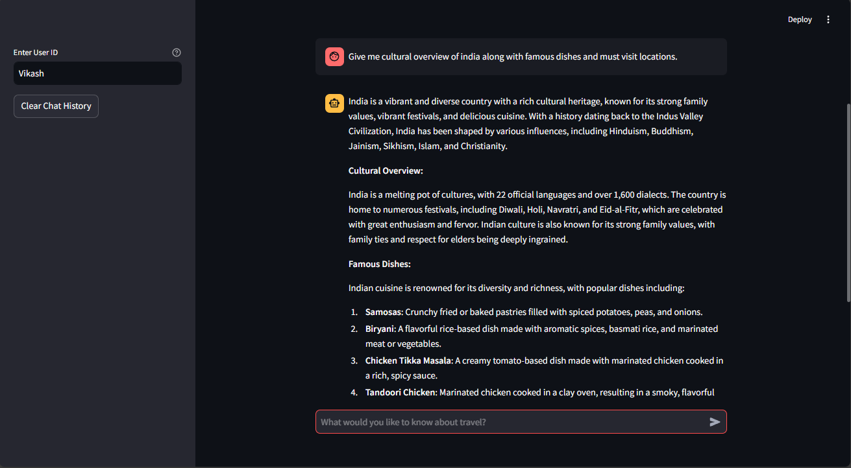
22

Slide 23
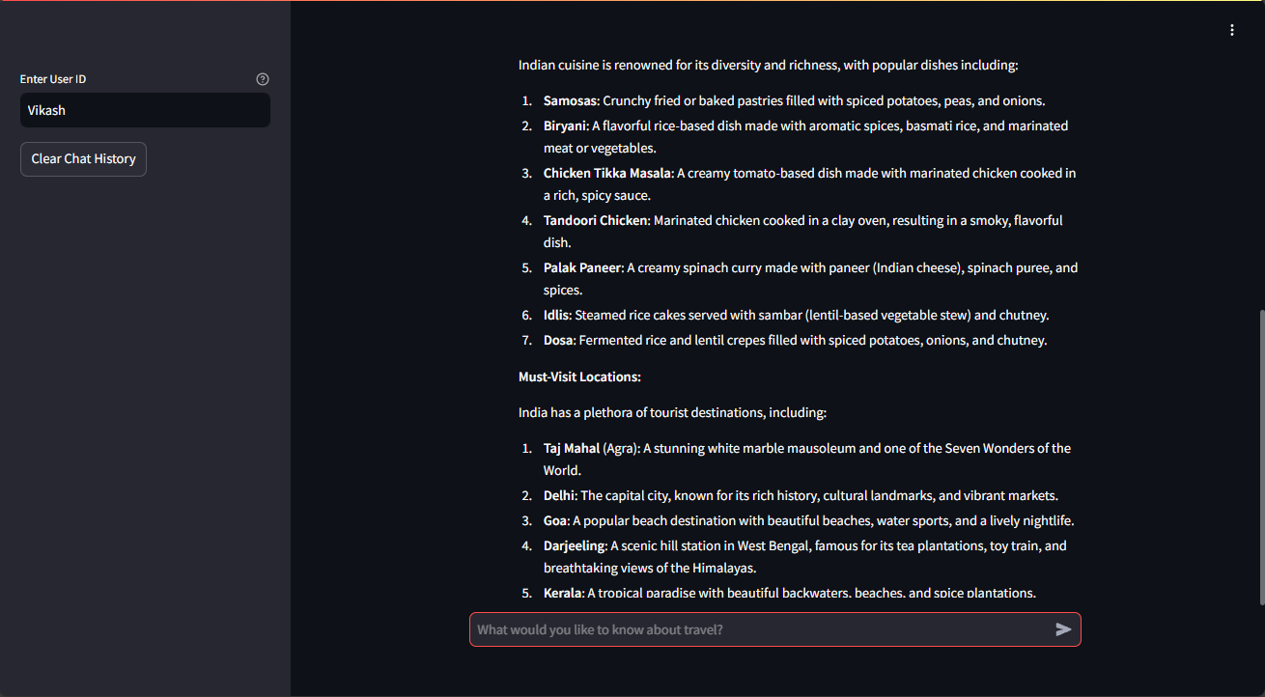
23

Slide 24
Thank you
Vikash Kushwaha
https://in.linkedin.com/in/vikash-kushwaha-931ab6269
https://github.com/MAHAKAAL-vk

